Slide 1



Network Anomaly Detection Using Machine Learning
Team Members:
Naveen Ajay Karasu
Chandana Chevuturi
Surya Simha Reddy Chinta
Pavan Kumar Reddy Bhumireddy
Sai Yashwanth Reddy Gujjula

Slide 2
TABLE OF CONTENTS
01
02
03
04
05
Project Overview
Dataset and Preprocessing
Methodology
Models Used
System Implementation
06
Conclusion and Future Work
Notes:
Project overview and Dataset preprocessing – Naveen Karasu
Methodology – Chandana
Models Used – Surya Simha
System Implementation – Pavan Kumar
Conclusion and Future Work – Yashwanth reddy

Slide 3

—Schneier, Bruce
“Attacks always get better, they never get worse.”

Slide 4

01
PROJECT OVERVIEW

Slide 5
Project Overview
OBJECTIVE
SCOPE
MOTIVATION
Enhance network security using AI
Detect DDOS attacks, bonets and Other malicious activities
Address limitations of traditional cybersecurity systems

Slide 6
02
DATASET AND PREPROCESSING

Slide 7
DATASET
DATASET
FEATURE’S USED
Kaggle’s Network anomaly Detection
CTU-13 Botnet Dataset
Packet count
Protocol type
Connection duration

Slide 8
PREPROCESSING
NORMALIZATION
MISSING VALUE’S
BATCH PROCESSING
Notes:
Normalization using standard scalar
Missing value imputation using simple imputer
Batch processing for large scale data

Slide 9
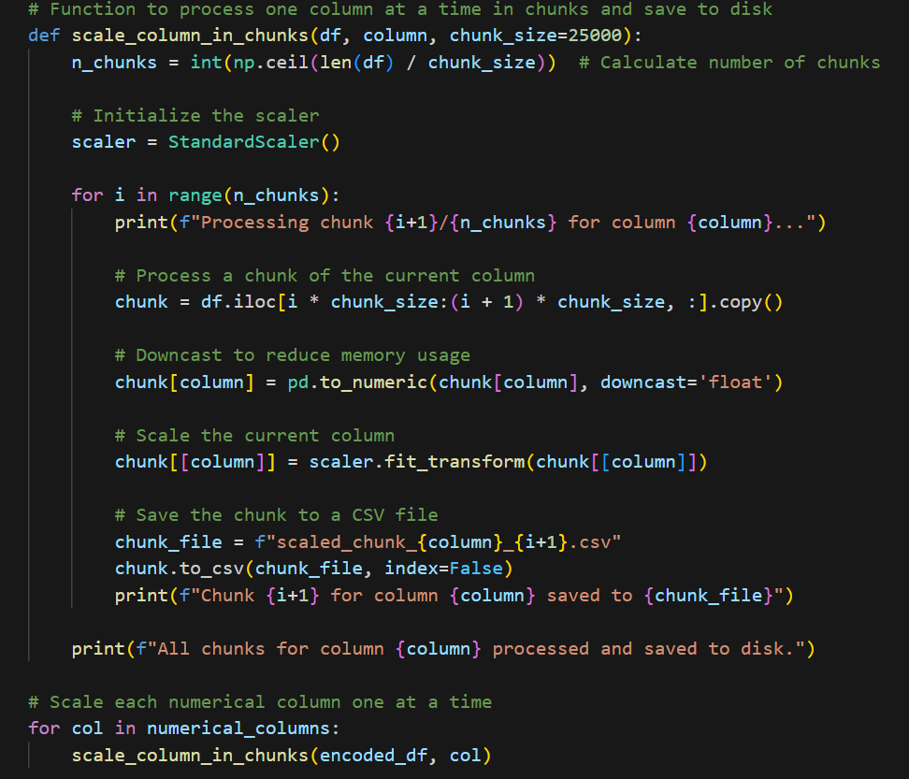
BATCH PROCESSING
We did batch scaling with each batch containing 100,000 records saved as a separate .CSV file.
During initial attempts, we encountered memory allocation errors when trying with batch size116.
Increasing the number of batches to 424 resolved the memory allocation issues

Slide 10
03
METHODOLOGY

Slide 11
Methodology
APPROACH
WORKFLOW
Clustering for anomaly detection
Binary classifcation for anomaly identification
Preprocessing
Model Training
Evaluation
Notes:
Workflow: preprocessing -> model training -> evalutation

Slide 12
WORKFLOW
Preprocessing
STAGE 1
Model Training
STAGE 2
Evaluation
STAGE 3

Slide 13
04
MODELS USED

Slide 14
Models
K-MEANS
DBSCAN
ISOLATION FOREST
Groups data into clusters.
Benefits: Simple, fast
Limitations: Fixed cluster numbers
Detects density-based clusters
Identifies noise as anomalies
Recursive partitioning for anomaly detection.
Effective for high-dimensional data.

Slide 15
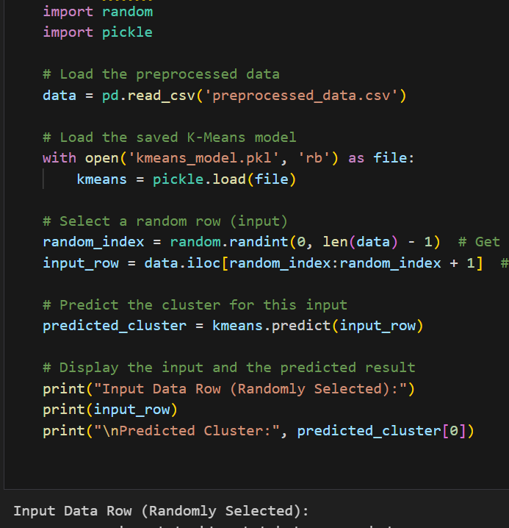
K-MEANS

Slide 16
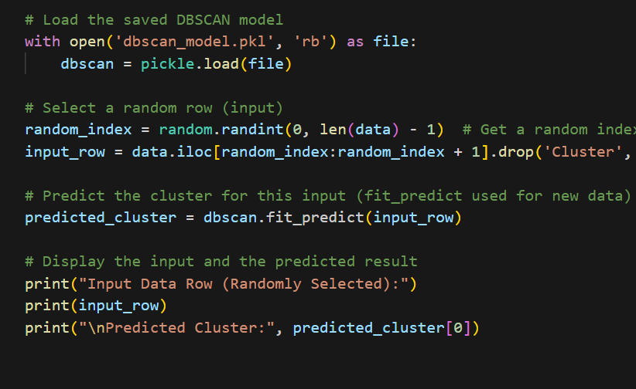
DBSCAN

Slide 17
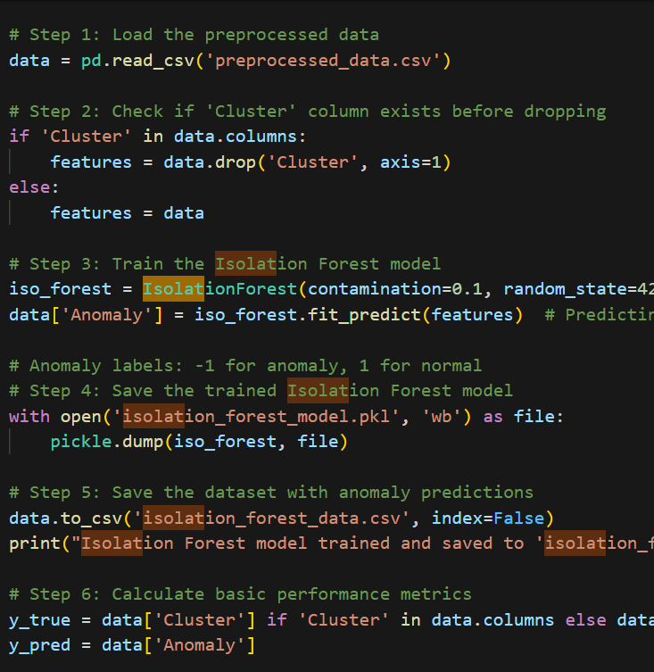
ISOLATION FOREST

Slide 18
05
RESULTS

Slide 19
RESULTS
PERFORMANCE METRICS
.K-Means: Silhouette score: 0.965, Inertia: 34310.68.
DBSCAN: Silhouette score: 0.859, Davies-Bouldin Index: 0.151.
Isolation Forest: Precision, Recall, F1-Score: 1.0.

Slide 20
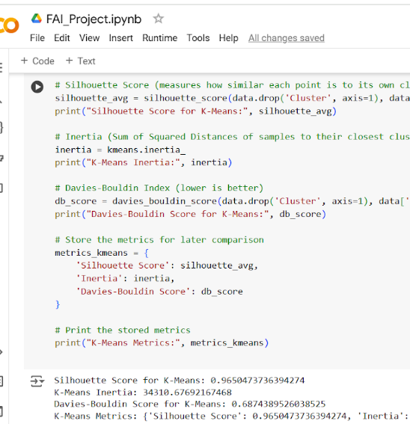
K-MEANS

Slide 21
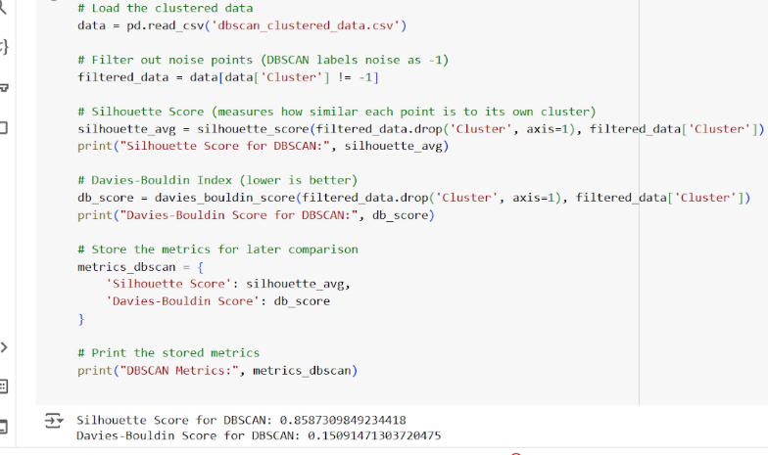
DBSCAN

Slide 22
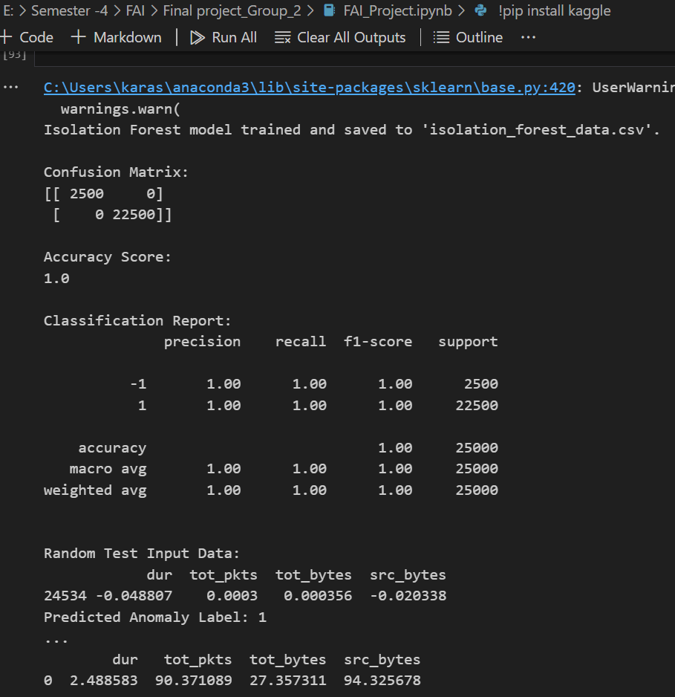
ISOLATION FOREST

Slide 23
06
SYSTEM IMPLEMENTATION

Slide 24
SYSTEM IMPLEMENTATION
FLASK-BASED WEB APP FOR ANOMALY DETECTIONS
FEATURES
INTERACTIVE USER INTERFACE WITH REAL-TIME INSIGHTS
INPUT: dur, tot_bytes, src_bytes
OUTPUT: Prediction from all models

Slide 25
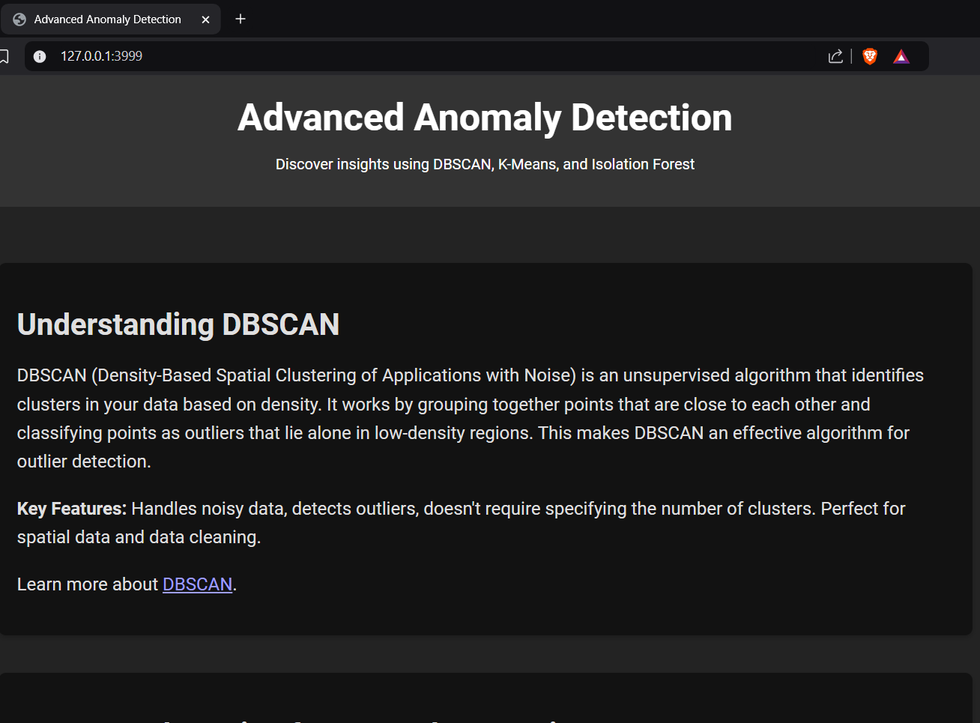
LANDING PAGE

Slide 26
07
CONCLUSION AND FUTURE WORK

Slide 27
FUTURE WORK
Real-time data processing
Enhanced visualizations
Create workflows to automate tasks.

Slide 28
CONCLUSION
AI improves the network anomaly detection
Comprehensive clustering and anomaly detection achieved

Slide 29
References
Schneier, B. (2009, July 30). New attack on AES. Schneier on Security. https://www.schneier.com/blog/archives/2009/07/new_attack_on_a.html
Ahmed, M., Mahmood, A. N., & Hu, J. (2016). A survey of network anomaly detection techniques. Journal of Network and Computer Applications, https://doi.org/10.1016/j.jnca.2015.11.016
Ariyaluran Habeeb, R. A., Nasaruddin, F., Gani, A., Hashem, I. A. T., Ahmed, E., & Imran, M. (2019). Real-time big data processing for anomaly detection: A Survey. International Journal of Information Management, 45, 289-307. https://doi.org/10.1016/j.ijinfomgt.2018.08.006
Parwez, M. S., Rawat, D. B., & Garuba, M. (2017). Big data analytics for user-activity analysis and user-anomaly detection in mobile wireless Network. IEEE Transactions on Industrial Informatics, 13(4), 2058-2065. https://doi.org/10.1109/TII.2017.2650206
Stratosphere Research Laboratory. (2011). The CTU-13 dataset: A labeled dataset with botnet, normal, and background traffic. Retrieved from https://mcfp.weebly.com/the-ctu-13-dataset-a-labeled dataset-with-botnet-normal-and-background traffic.html

Slide 30
THANK YOU!

